Slide 1



INSTITUTE : UIE
DEPARTMENT : CSE
Bachelor of Engineering (Computer Science & Engineering)
Disruptive Technologies-3
(23CSH-203)
Topic: cloud computing
DISCOVER . LEARN . EMPOWER
Notes:
1

Slide 2
Learning Objectives & Outcomes
Objective:
To understand the meaning of cloud and cloud Computing
Outcome:
Student will understand
The meaning of cloud and cloud Computing
How its works

Slide 3
Cloud Computing

Slide 4
What is Broad Network Access?
The ability to access network resources and services from a variety of locations and devices is referred to as "broad network access," a term that is frequently used in the context of cloud computing. According to the National Institute of Standards and Technology (NIST), it is one of the crucial elements of cloud computing.
Users can use a variety of devices, including desktop computers, laptops, smartphones, tablets, and other internet-connected gadgets, to access cloud services and applications thanks to Broad Network Access. Standard network protocols and technologies, typically using the Internet as the underlying network infrastructure, enable this accessibility.
Notes:
4

Slide 5
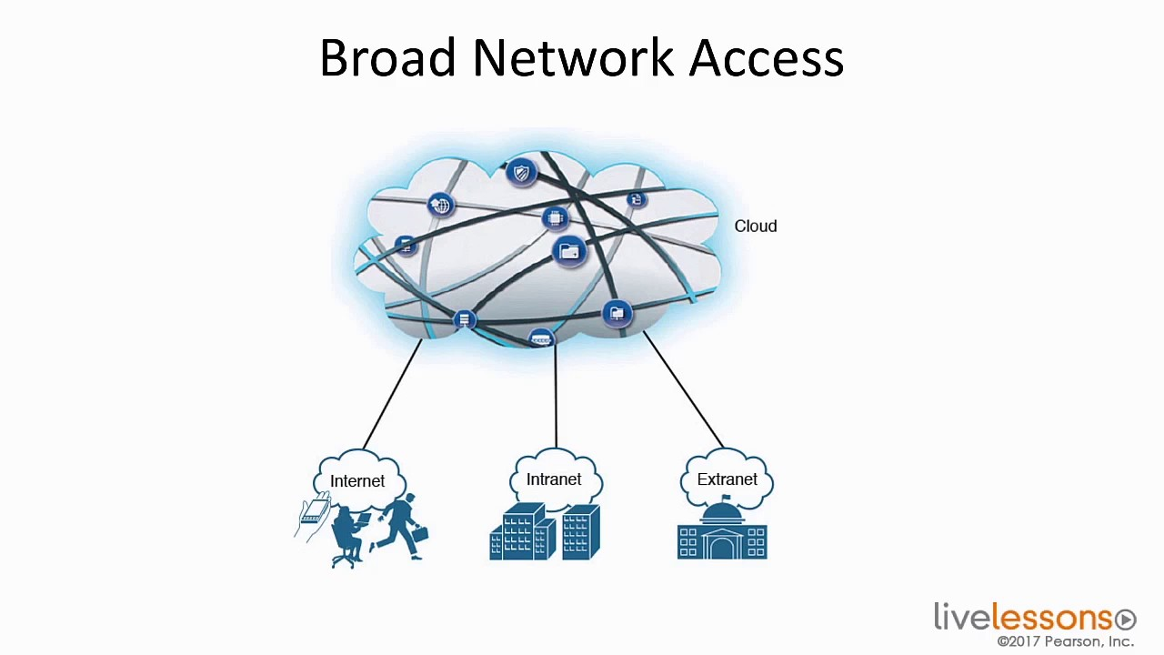

Slide 6
What does Broad Network Access do?
Users can remotely access cloud resources and services using Broad Network Access from any location with an internet connection. They are not constrained to particular geographical regions or particular gadget categories. Users can work on or interact with cloud-based applications and data from a variety of locations and devices thanks to this flexibility and accessibility, which offers convenience, scalability, and increased productivity.
Additionally, Broad Network Access makes it easier for users in various locations to collaborate. Real-time collaboration and improved teamwork are made possible by the ability for multiple users to access and work on the same cloud-based applications or documents at once. Broad Network Access in cloud computing makes sure that users can access cloud services and resources from a variety of devices and locations, enabling flexible, widespread, and cooperative use of cloud-based applications and data.

Slide 7
What does Broad Network Access do?
In conclusion , Broad Network Access is crucial in the world of cloud computing. Users can use a variety of locations and devices to access network resources and services, which promotes flexibility, convenience, and teamwork. Users are no longer restricted to particular physical locations or constrained by the type of device they use thanks to the ability to connect to cloud services remotely through a variety of devices. With this freedom comes the ability to interact with cloud-based data and applications with ease, which boosts productivity and scalability.
Through real-time collaboration and the promotion of a more connected and effective digital ecosystem, broad network access enables people and teams to collaborate successfully across geographic boundaries. Broad Network Access will remain a key component of cloud computing as it develops, empowering users.

Slide 8
Resource pool
A resource pool is a group of resources that can be assigned to users. Resources of any kind, including computation, network, and storage, can be pooled. It adds an abstraction layer that enables uniform resource use and presentation. In cloud data centers, a sizable pool of physical resources is maintained and made available to consumers as virtual services.
Any resource from this pool may be given to one user or application only, or it may even be shared by several users or apps. Additionally, resources are dynamically provided according to need rather than being permanently allocated to users. As load or demand fluctuates over time, this results in efficient resource usage.
5
Notes:
8

Slide 9
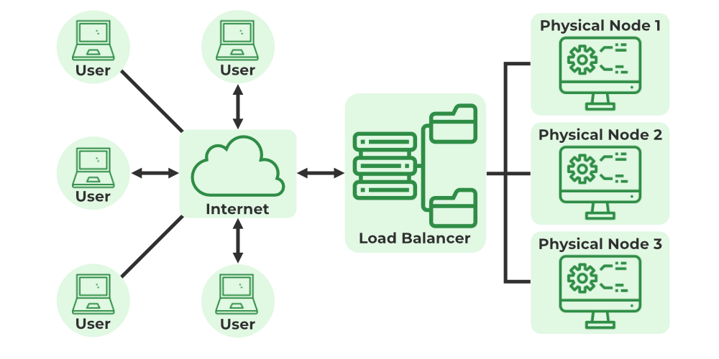
Resource Pooling Architecture
This architecture is predicated on the utilization of one or more resources from a pool of resources, wherein a system groups and manages identical synchronized resources.
Physical Server Pools
These are a collection of physical servers that are networked together and are ready for use right away thanks to the installation of operating systems and other essential programmed and/or applications.
9

Slide 10

Virtual Server Pools
It is a networked collection of virtual servers that have operating systems and other required software installed and are ready for use right away. Typically, they are set up using one of the many accessible templates that the cloud consumer has selected during provisioning. for instance, a cloud user may create a pool of low-tier Ubuntu servers with 2 GB of RAM or a pool of mid-tier Windows servers with 4 GB of RAM.

Slide 11
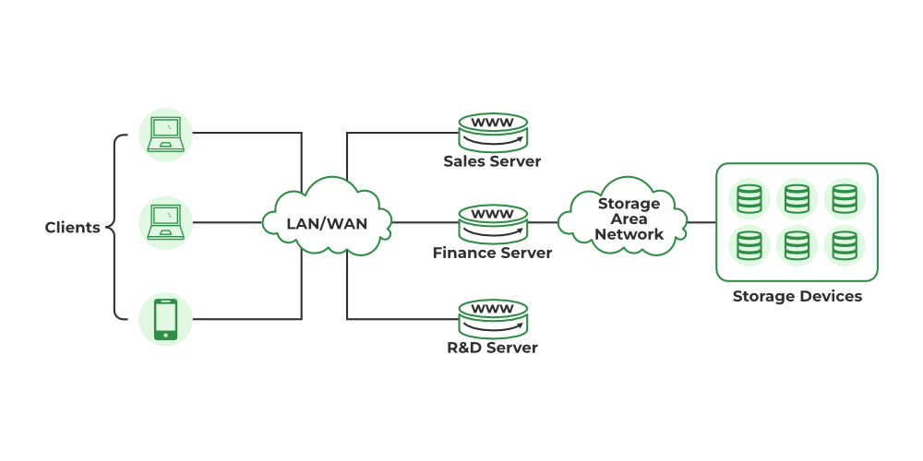
Cloud Storage Device Pools
It is a collection of block- or file-based storage structures that house both empty and/or populated cloud storage devices. One of the crucial elements required for enhancing performance, data management, and protection is storage resources. Users and apps often access it, and it’s required to satisfy expanding requirements, keep backups, migrate data, etc.
Storage pools, which are accessible to users in virtualized mode, are made up of file-based, block-based, or object-based storage made up of storage devices like discs or tapes.

Slide 12
Network Pools (Interconnect Pools)
It is a collection of several preset network connectivity devices, such as a virtual firewall device pool or physical network switches, that can be used for load balancing, redundancy connectivity, etc. Through network infrastructure, resources in pools can be linked to one another or to resources in other pools. Switches, routers, gateways, and other networking hardware make up network pools. These physical networking devices are then used to build virtual networks that are provided to clients. These virtual networks can be used by customers to further develop their own networks.
Data centers typically retain specialized pools of resources of various types. They could also be developed specifically for users or apps. Pool management and organization become more difficult when resources and pools multiply. To meet various resource pooling needs, hierarchical structures can be employed to create parent-child, sibling, or nested pools.
11

Slide 13
CPU Pools
These are a collection of processing units that are prepared to be assigned to virtual servers and are often divided into separate processing cores. img4
Physical server pools can be used to vertically scale physical servers or to provision new physical servers.
Each sort of resource can have a specific pool built for it, and smaller pools can be made up of larger ones, in which case each one becomes a sub-pool.
Multiple pools may be formed for different cloud users or apps, which might lead to extremely complicated resource pools.
As demonstrated in the image below, a hierarchical structure can be created to create parent, sibling, and nested pools to make it easier to organize various resource pooling requirements.

Slide 14
References
Text books:
Buyya, Rajkumar, James Broberg, and Andrzej M. Goscinski, eds. Cloud computing: Principles and paradigms. Vol. 87. John Wiley & Sons, 2010.
Miller, Michael. Cloud computing: Web-based applications that change the way you work and collaborate online. Que publishing, 2008
Websites:
https://www.javatpoint.com/cloud-computing-vs-grid-computing
https://www.javatpoint.com/cloud-computing-vs-grid-computing
https://www.eukhost.com/blog/webhosting/what-is-utility-computing/

Slide 15
THANK YOU

